Slide 1


Sandia Clinic
Low-Power, Context-Aware Global Positioning System
By
Chris Chadwick
Rashin Bolkameh
Michael Stevens
Daniel Rolfe
Eric Hsu
Faculty Advisor:
Dr. Cameron Charles
Special Thanks To:
Steven Paradise
Adrian Wong

Slide 2
Outline
Rashin Bolkameh
“Introduction to GPS Tracking System and Project history”
Chris Chadwick
“Hardware Design”
Michael Stevens
“Board Design”
Daniel Rolfe
“Programming the Utah GPS Stack”
Eric Hsu
“Testing and Results”

Slide 3
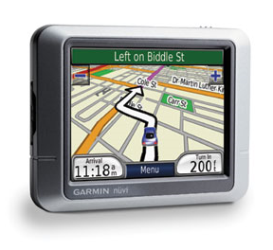
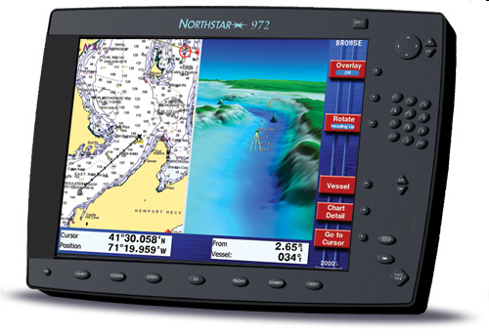
Introduction
The Global Positioning System (GPS) is a fully functional Global Navigation Satellite System (GNSS).

Slide 4
Introduction
Transmit the time
A precise orbit for the satellite
General system health
Rough orbits of all the GPS satellites
Receiver uses data to calculate their position

Slide 5
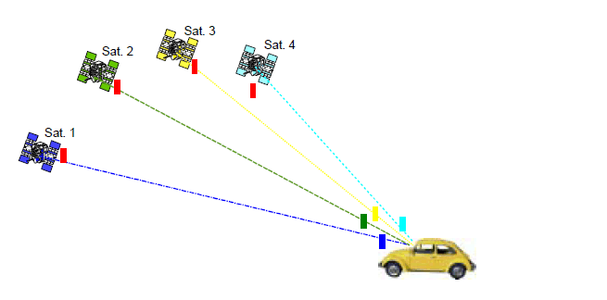
Introduction
Four satellites are needed to determine a GPS coordinate consists of:
Latitude
Longitude
Altitude
The exact time

Slide 6
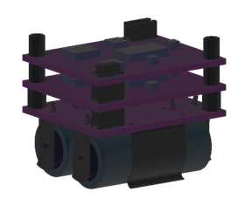
OBJECTIVES
Adding a low power GPS board to the Sandia GPS stack
Compatible with Sandia's boards
Be able to capture a short sample of the GPS satellite signal
Store data into the serial flash memory
Sandia stack

Slide 7
Sandia stack
Sandia uses a stack of boards
Each board has its own functionality
Boards communicate with Sandia stack
Boards include:
power board
data storage board
board for communication
various sensor boards
Sandia stack

Slide 8
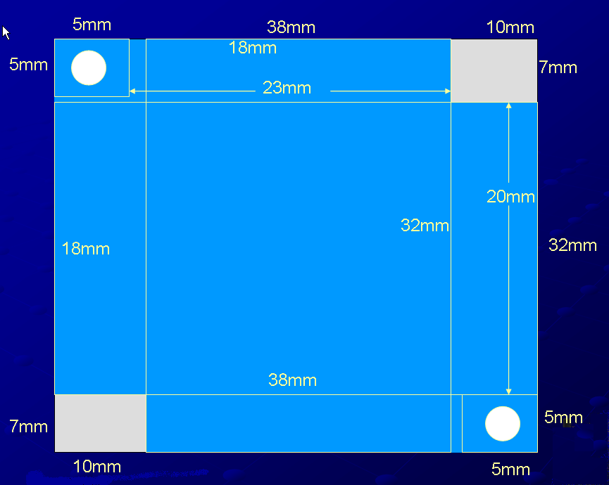
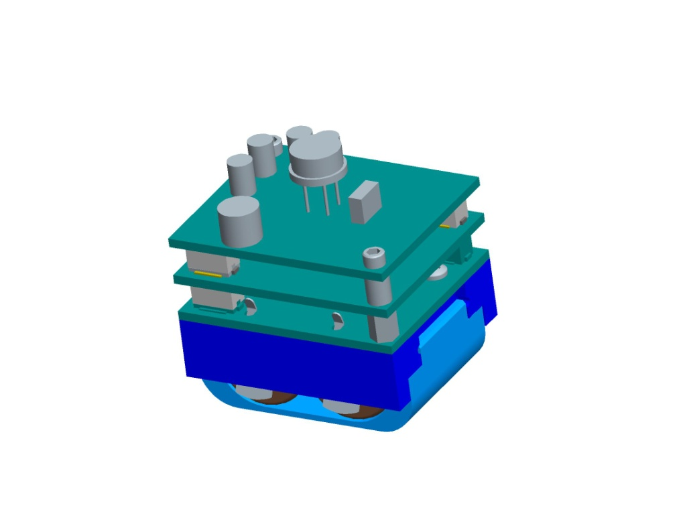
Requirements
To be compatible:
- Size requirement:
38mm x 32mm
- Spacing:
5mm between boards
- Limit components:
3.5 mm tall on top
1.5 mm tall on bottom
Sandia stack
0.3”
0.6”
1.25”
1.5”

Slide 9
Requirements
In addition to the size:
Minimize power consumption
Device runs off two batteries
Must be compatible with the Sandia stack
Both the hardware and software has be designed

Slide 10
Hardware design
Hardware includes:
- Selecting components
- System-level design to interface the GPS and
accelerometer
- Printed circuit board (PCB) design
- Fabrication and Assembly

Slide 11
software design
Software includes:
- writing firmware to run on the
microcontroller
- writing software for positioning data post-
processing

Slide 12
goal
To place a chip with a GPS receiver
Utilizing a GPS front-end module
Must be compatible with the Sandia stack
Calculate position with less than one second of data
Power consumption:
Accessing a database of GPS information
Use an accelerometer to lower the power

Slide 13
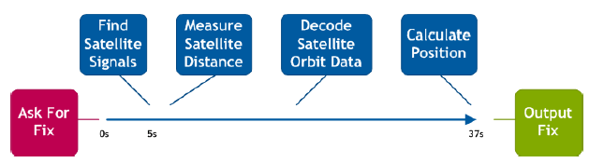
GPS receiver
The tasks of a conventional GPS receiver are as follows:
- GPS receiver searches for the weak satellite signals
- It measures their relative timing accurately to give
the distance to the satellites
- Calculate the position on the fly (delay)
- Cold state time (37s)
- Hot state time (5s)

Slide 14
GPS receiver
Geotate’s software:
- An independent software
- Provide users an ability to find their location
- Automatically adds location labels to your
photos

Slide 15
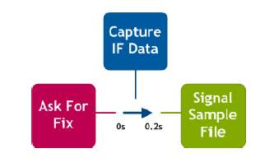
GPS receiver
The tasks of our GPS receiver or Geotate GPS receiver
are as follows:
- Low energy consumption
- Short sample of the GPS satellite signal (less
than 1/5th second) is simply captured
- No delay for any processing task to be performed
- Sends the signal samples
to their PC
- Size of captured GPS
(128KB)

Slide 16
Hardware Architecture
Hardware Design
Identify the problem and find solution
Find components
Read data sheets
Figure out how components fit together
Return to step 1

Slide 17
Sandia requirements
Problems
Capturing of raw GPS data
Removal of raw GPS data from board to PC
Detection of movement
Low power
Must conform to the Sandia stack specs

Slide 18
Gps front end modules
SiGe
Testing sample
Software available
Rakon
Software available
Maxim
Software available

Slide 19
Processing software
Matlab
Works with SiGe
Requires approximately 1GB of data
Owned the software
Geotate
Works with Rakon and Maxim
Requires 128kbit’s of data

Slide 20
Types of flash memory
Nand Flash
Used in many devices
Requires writhing in pages
μSD
Use SPI or SD protocols
Requires writhing in pages
Serial Nor Flash
Smaller
Does not require writhing in pages

Slide 21
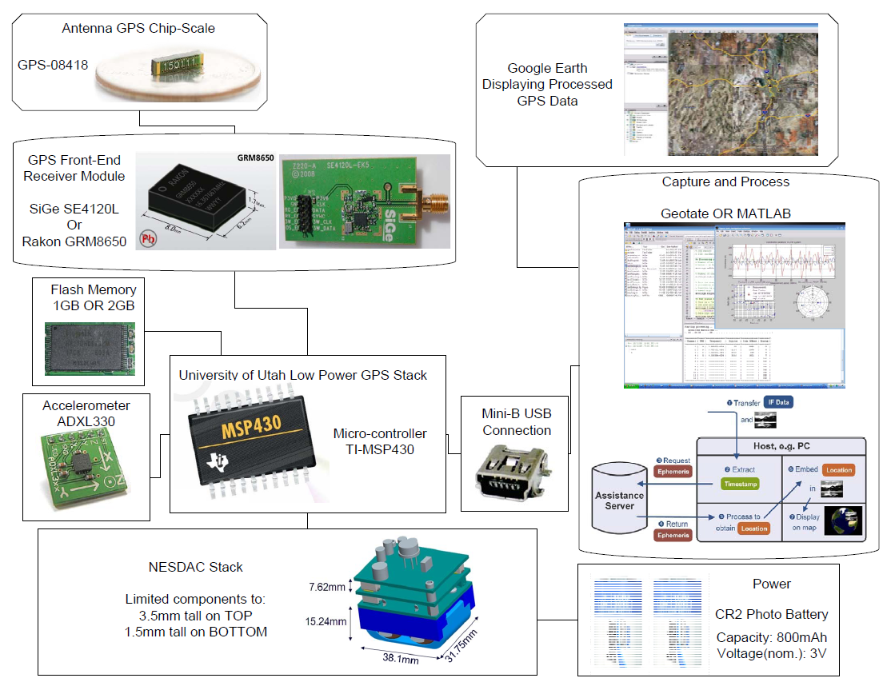
Revision 1
Sandia Stack

Slide 22
Revision 1 problems
USB Controller
Complex requirements
Writing drivers
Use a lot of power
Controller chosen was not right for application

Slide 23
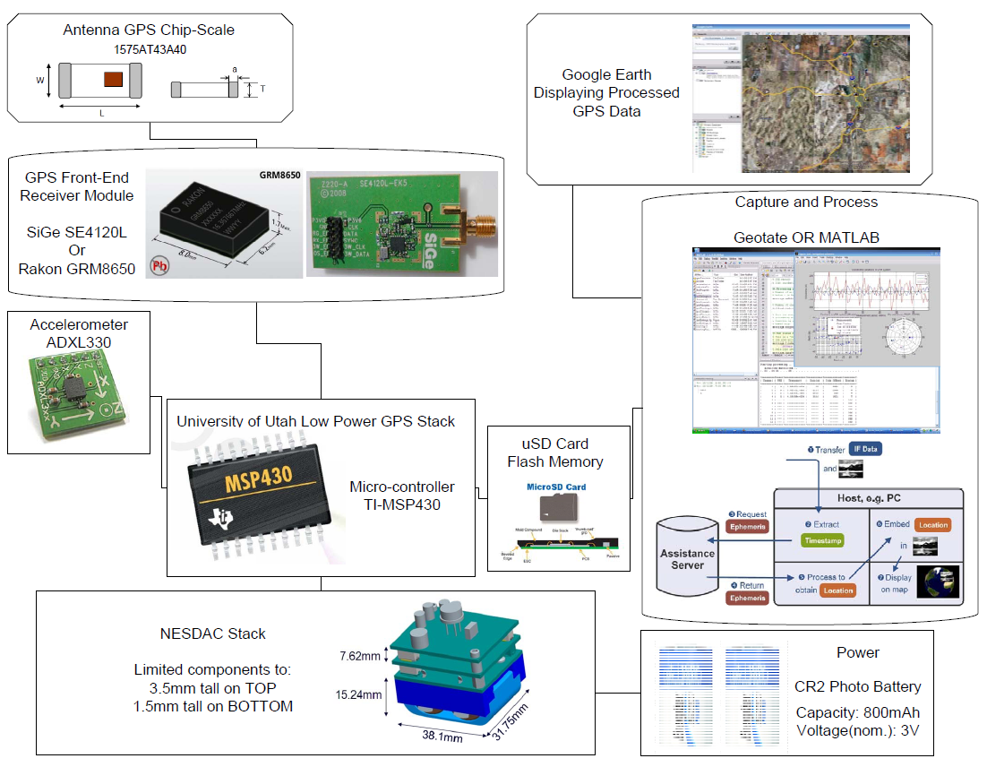
Revision 2
Sandia Stack

Slide 24
Revision 2 problems
Software
Unable to obtain Geotate Software
Unable to reduce Matlab Capture size
SiGe and μController
μController clock 8 Mhz
SiGe data rate is 16 Mbit/s

Slide 25
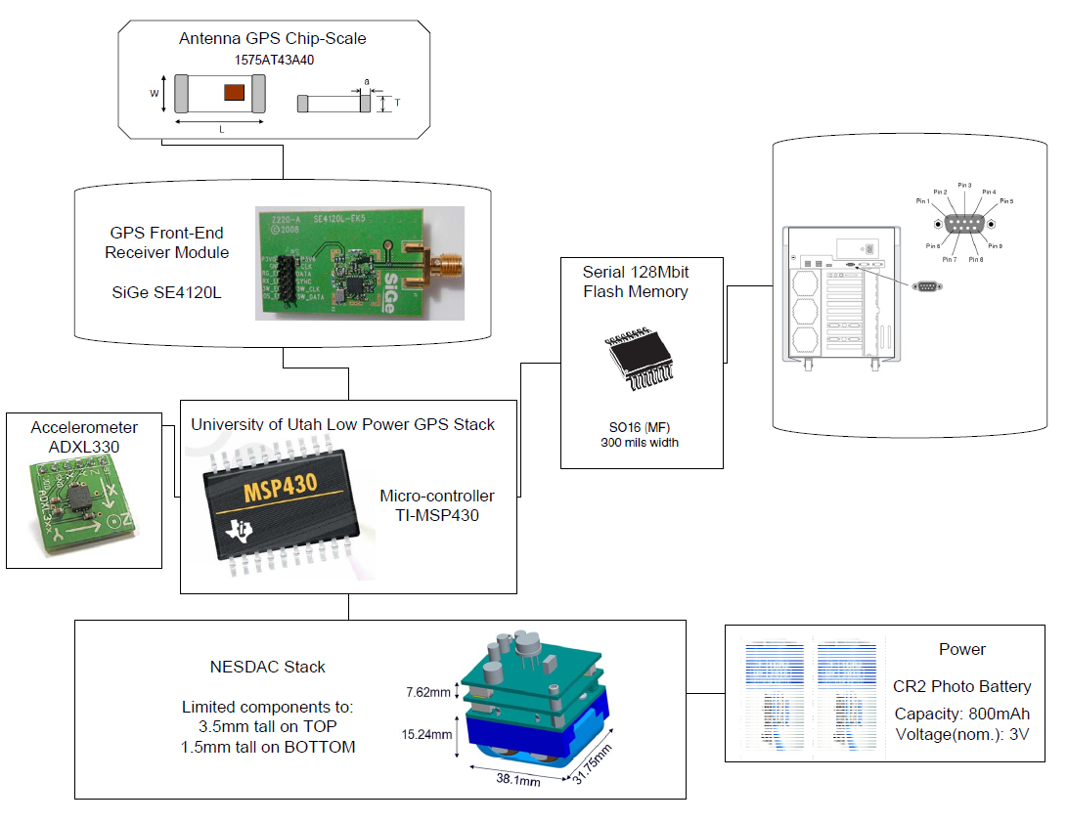
Revision 3
Sandia Stack

Slide 26
Board design
Using Cadsoft Eagle to create a PCB
Creating a symbol and package
Creating a schematic
Using electrical rule check
Generating the layout from schematic
Using design rule check and autorouter
Creating gerber files
Using Viewplot to view gerber files

Slide 27
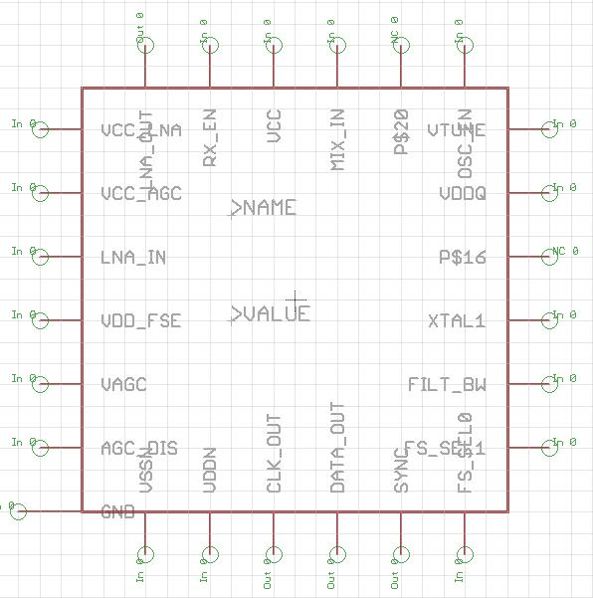
symbol
Eagle contains a lot of premade parts
Draw shape used in schematic and add all required pins

Slide 28
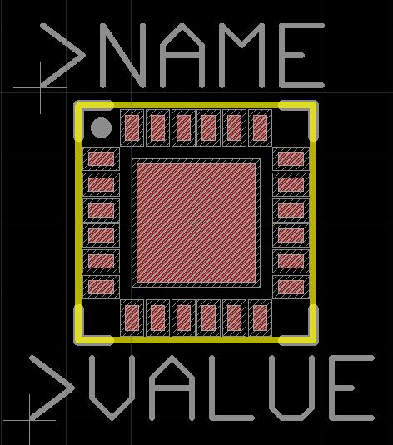
Footprint
Draw the required layout from the datasheet
Three main layers – silkscreen, copper, solder mask
Two types – surface mount and through hole

Slide 29
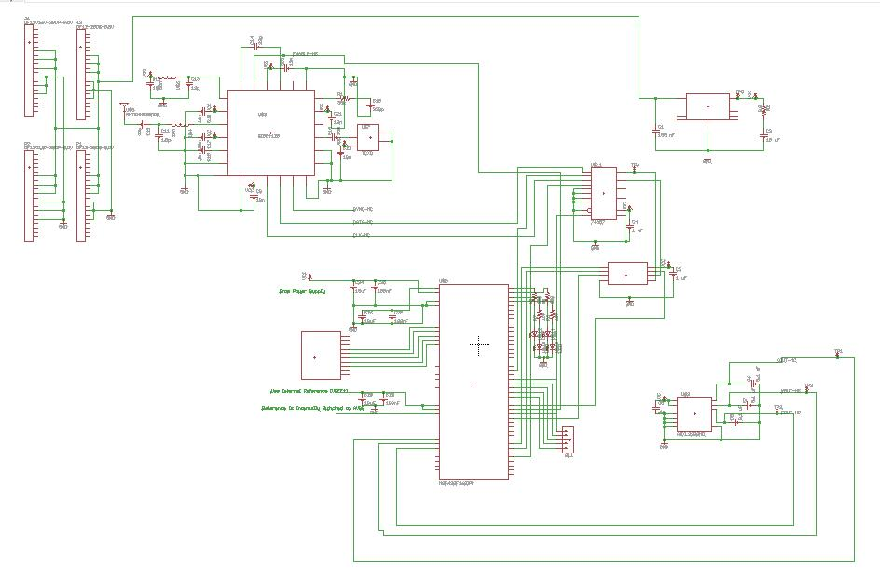
schematic
Make all connections
Add labels to important nets
Can generate a partslist

Slide 30
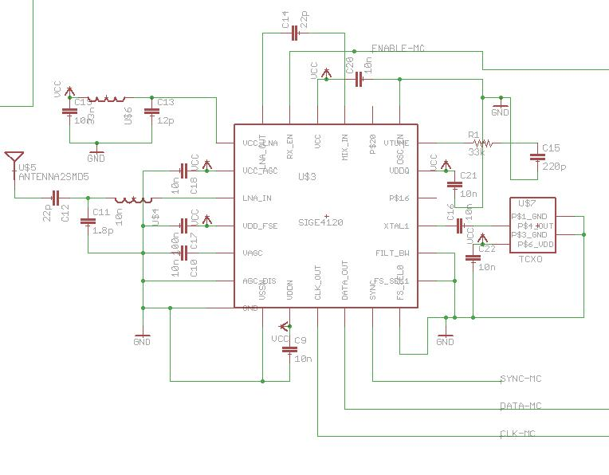
Schematic
Text
Use recommended schematic from datasheet
Add decoupling capacitors to prevent voltage spikes

Slide 31
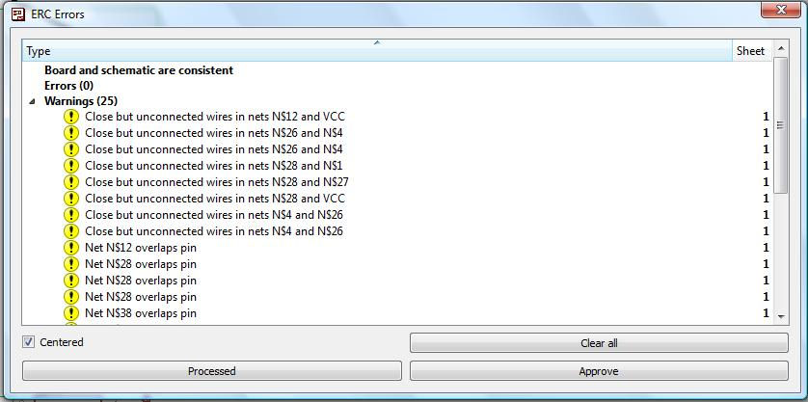
Electrical Rule Check
Checks that all pins are connected
Warnings for close but unconnected nets
Checks for schematic/layout consistency

Slide 32
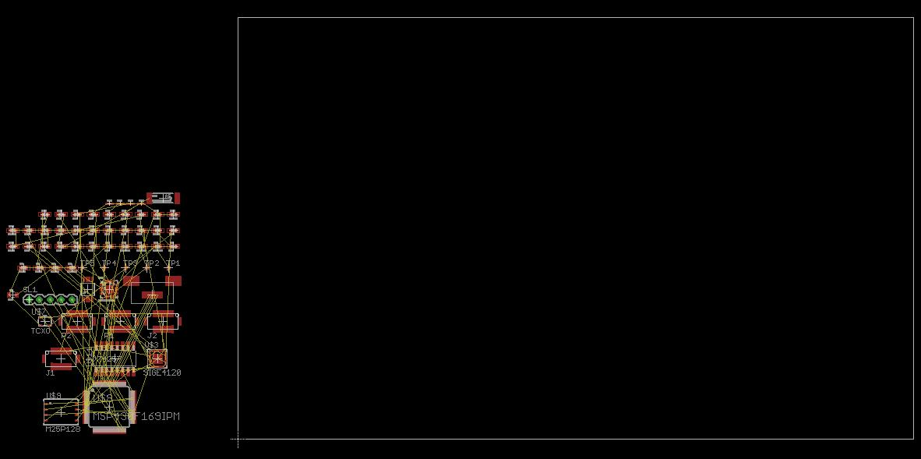
Generate Layout
Size the board
Move all parts and airwires to desired location

Slide 33
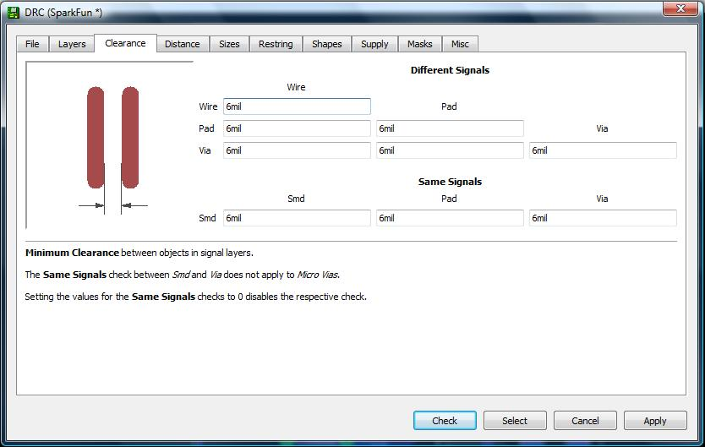
Design rule check
Set rules for minimum sizing/spacing
Rules used for the autorouter

Slide 34
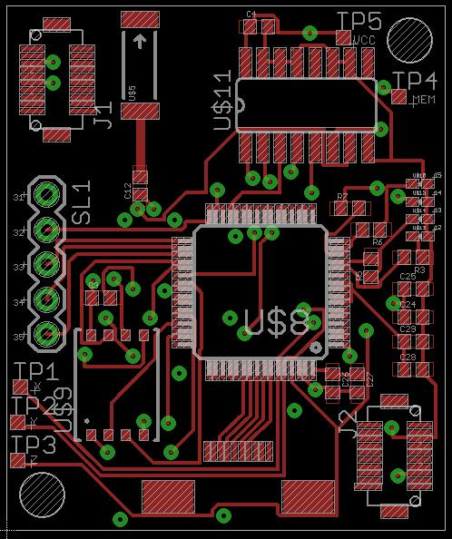
Board top
Autorouter has 4 levels of optimization
Manual route where necessary

Slide 35
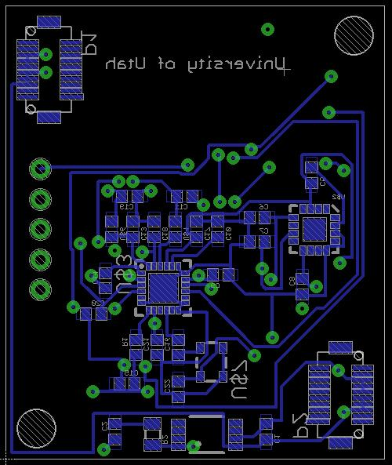
Board bottom
Similar to top but mirrored

Slide 36
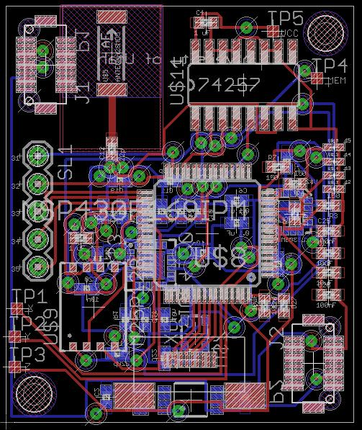
Complete layout
4 layer board
Generate a centroid file

Slide 37
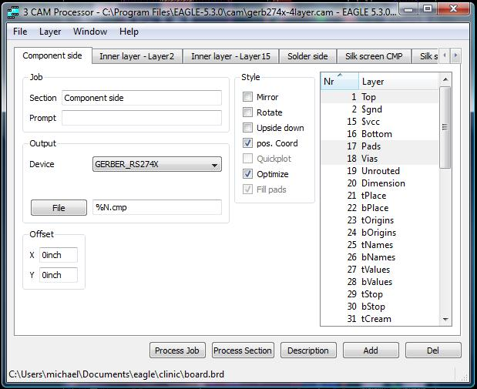
Cam processor
Gerber file is a text file describing each layer
Select eagle layers to be included in each

Slide 38
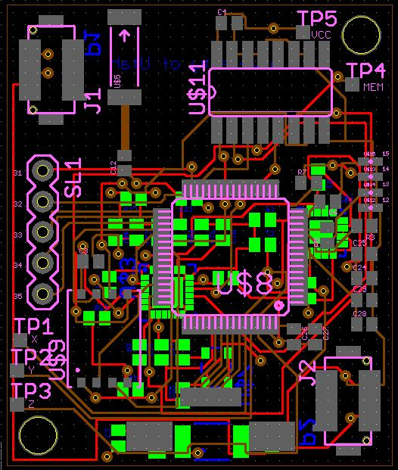
viewplot
Used to view gerber files
Good check of what will be sent for fabrication

Slide 39
Fabrication
Complete gerber files sent for fabrication
Sierra Proto Express
Create BOM from partslist
Order all necessary parts
Send parts, boards, BOM, and centroid for assembly
PCB Solutions

Slide 40
Sandia Clinic
Programming and Code Design
Picking a development environment
Developing custom code for the GPS board

Slide 41
Programming environment
Texas Instruments provides two development environment software options
Code Composer Essentials
IAR Embedded Workbench Kickstart

Slide 42
IAR Kickstart
Similar to development software like Eclipse or Visual Studio
Some key differences are
Selecting the TI MSP430 chip to work with
Multiple debugging modes
Simulating interrupts

Slide 43
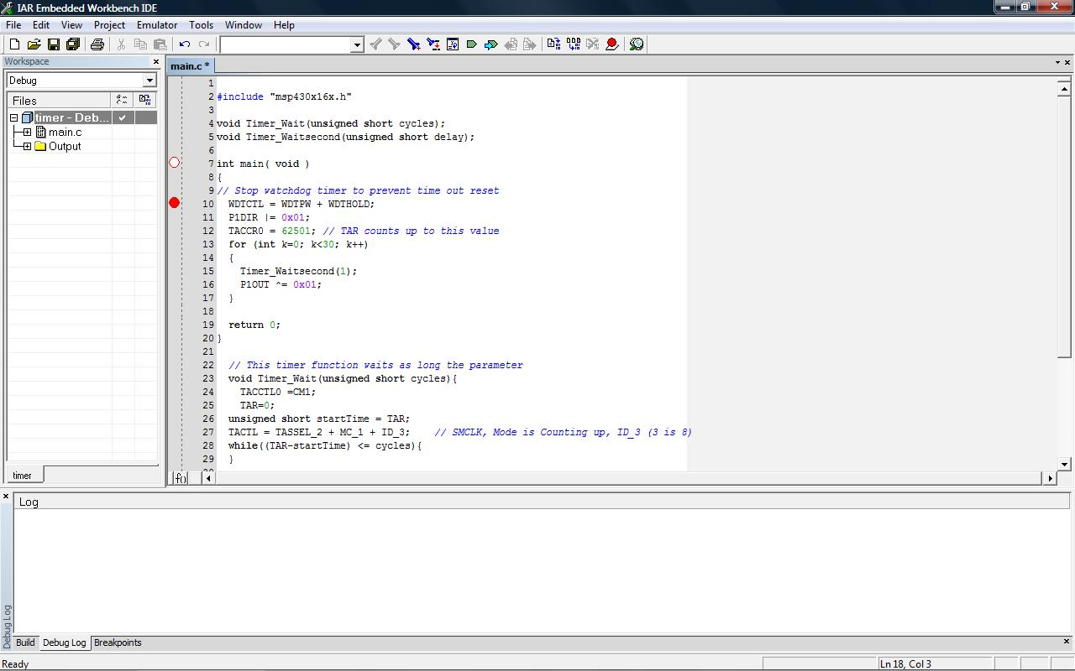
IAR workbench

Slide 44
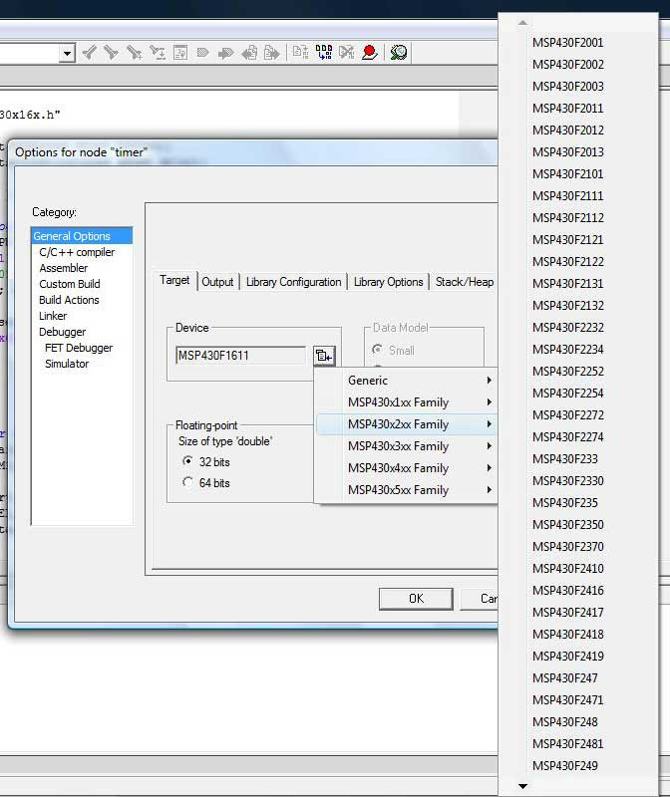
IAR workbench

Slide 45
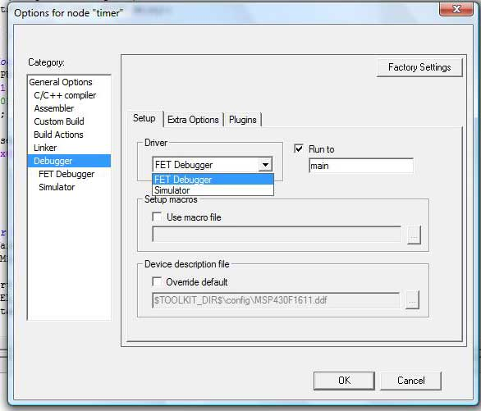
IAR workbench

Slide 46
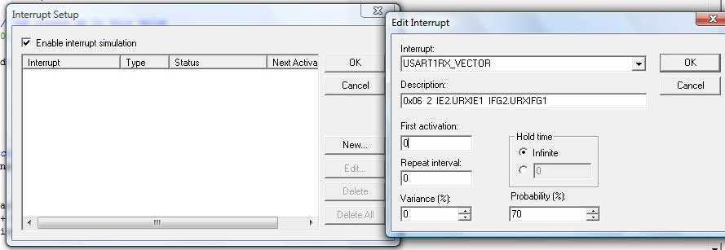
IAR workbench

Slide 47
Program overview
main
Setup UART
interrupt
Wait for
signal
Setup ADC
interrupt
Setup SPI
interrupt
Wait for signal
Wait for signal
Erase
flash
finished
Are all samples
Captured?
yes
Transfer to
U controller
yes
no
no
Wait for signal
More data to
Transfer?
Capture
Sample
Transfer to
PC

Slide 48
Main sections of code
Creating a timer to be able to accurately wait in the program
Getting GPS samples to memory
Transferring samples from memory to micro controller
Transferring samples from micro controller to PC
Making sure all interrupts are properly setup

Slide 49
timer
Needed a way to accurately time stalls in the program
There is no stored reference time to compare against
One way is to count clock ticks

Slide 50
Timer flowchart
Is cycleCount greater
than specified cycles?
yes
no
finished
Increment
CycleCount by 1

Slide 51
Acquiring gps samples
To complete the project GPS samples need to be captured
Samples will be stored locally, but processed off system
GPS samples are 128KB

Slide 52
Sample flowchart
Are GPS samples still needed?
no
yes
Wait for accelerometer Signal to trigger interrupt
wait 10 minutes
Turn on SiGe
Wait SiGe initialize time
Switch mux
Wait 200ms
Switch mux turn off SiGe
Increment total sample count

Slide 53
flowchart
main
Setup ADC
interrupt
Wait for signal
Are all samples
Captured?
yes
no
Capture
Sample

Slide 54
Flash memory to microcontroller
All of the GPS samples have now been collected
Only portions of the data will fit onto the micro controller
The micro controller will communicate with the serial flash via SPI protocol

Slide 55
Data from microcontroller to pc
The micro controller will have GPS sample data from flash
The data needs to be transferred to a PC for processing
The micro controller will communicate with the PC via UART protocol

Slide 56
Uart spi flowchart
Setup UART interrupt
Wait for ready signal from PC
Setup SPI interrupt
Request wanted data
Receive and store data on MCU
Sequentially transmit data on MCU to the computer
yes
Is there more data on the serial flash to transfer?
no
This part is finished

Slide 57
flowchart
main
Setup UART
interrupt
Wait for
signal
Setup ADC
interrupt
Setup SPI
interrupt
Wait for signal
Wait for signal
Are all samples
Captured?
yes
Transfer to
U controller
yes
no
no
Wait for signal
More data to
Transfer?
Capture
Sample
Transfer to
PC

Slide 58
Clearing the flash
We need to erase the flash before it can be used
If the serial flash is not erased it will not store data properly
When the serial flash writes it does not do direct copy, it flips 1 bits to 0 when needed

Slide 59
Overall flow
main
Setup UART
interrupt
Wait for
signal
Setup ADC
interrupt
Setup SPI
interrupt
Wait for signal
Wait for signal
Erase
flash
finished
Are all samples
Captured?
yes
Transfer to
U controller
yes
no
no
Wait for signal
More data to
Transfer?
Capture
Sample
Transfer to
PC

Slide 60
Final programming points
Changes I would make if I had more time
Adding a button on the hardware to indicate when the computer is ready for data
Attempt to rewrite the code to avoid nested interrupts

Slide 61
Sandia Clinic
Testing and Results
Manufactured board review
Problems encounter during testing
Fixes
Planned application
61

Slide 62
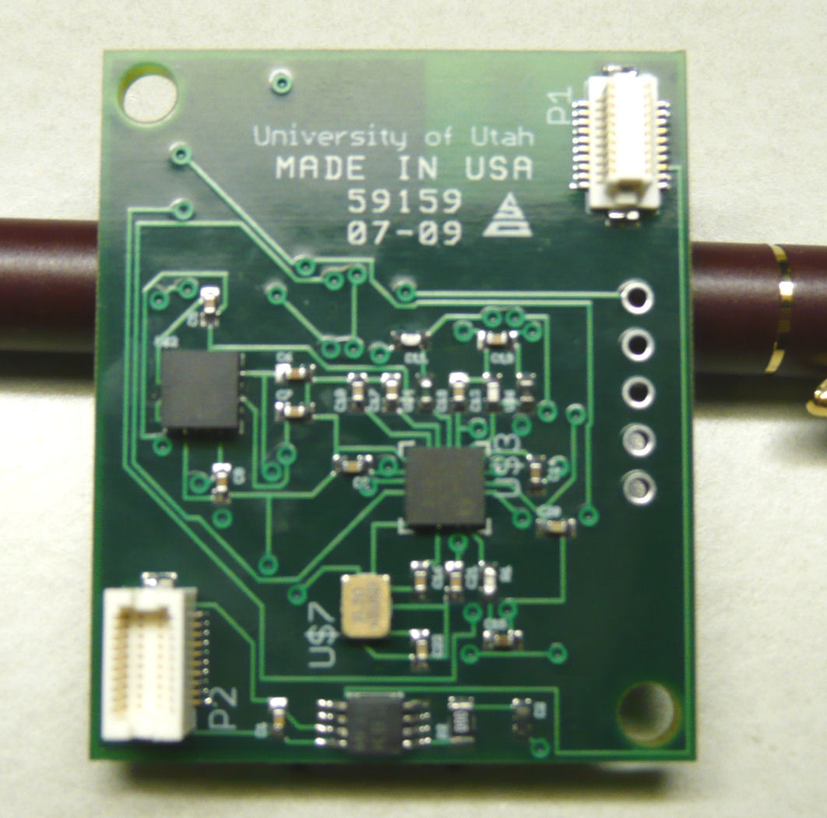
Bottom side

Slide 63
Bottom side
Small, Low Power, 3-Axis ±3g iMEMS Accelerometer

Slide 64
Bottom side
SiGE GNSS Receiver IC

Slide 65
Bottom side
Ultra-Low Quiescent Current LDO Voltage Regulator

Slide 66
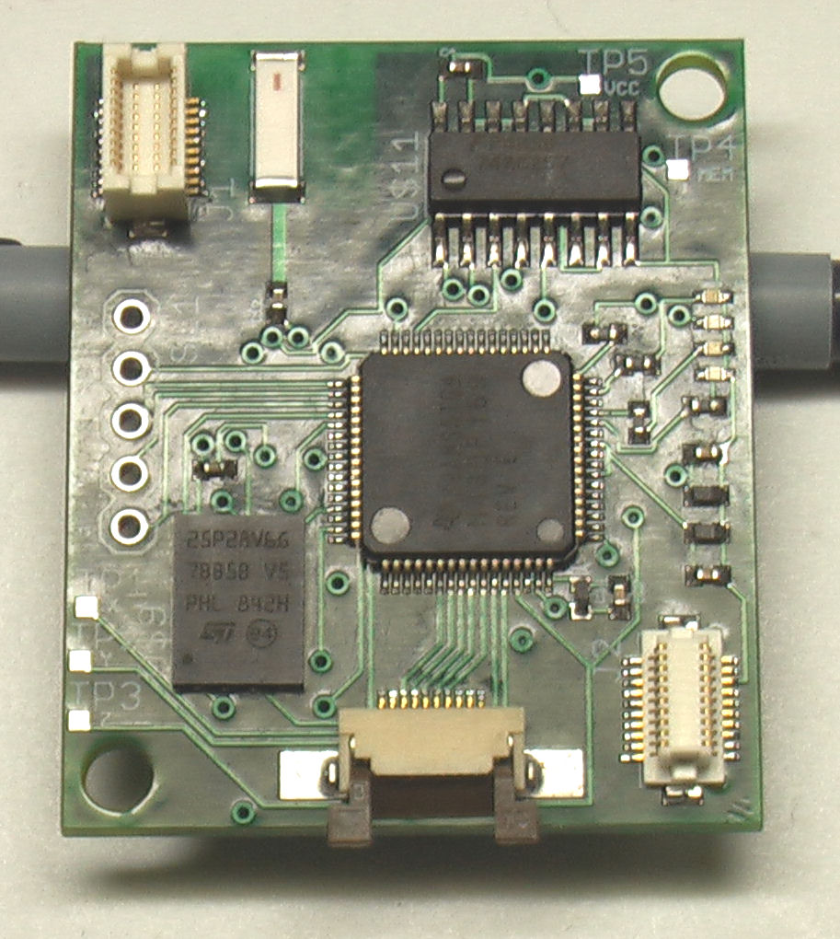
Top side

Slide 67
Top side
Unregulated Power

Slide 68
Top side
Quad 2-Input Multiplexer with 3-STATE Outputs

Slide 69
Top side
LEDs

Slide 70
Top side
RF Ceramic Antenna

Slide 71
Top side
TI MSP430 MIXED SIGNAL MICROCONTROLLER

Slide 72
Top side
128 Mbit (Multilevel), low-voltage, Serial Flash memory

Slide 73
Top side
Custom JTAG Port

Slide 74
Top side
Serial Connection

Slide 75
Lower Right Socket
Lower Right Socket was an incorrect footprint.
Remove
Do not power through it
Top Left Socket compensate for powering the board.

Slide 76
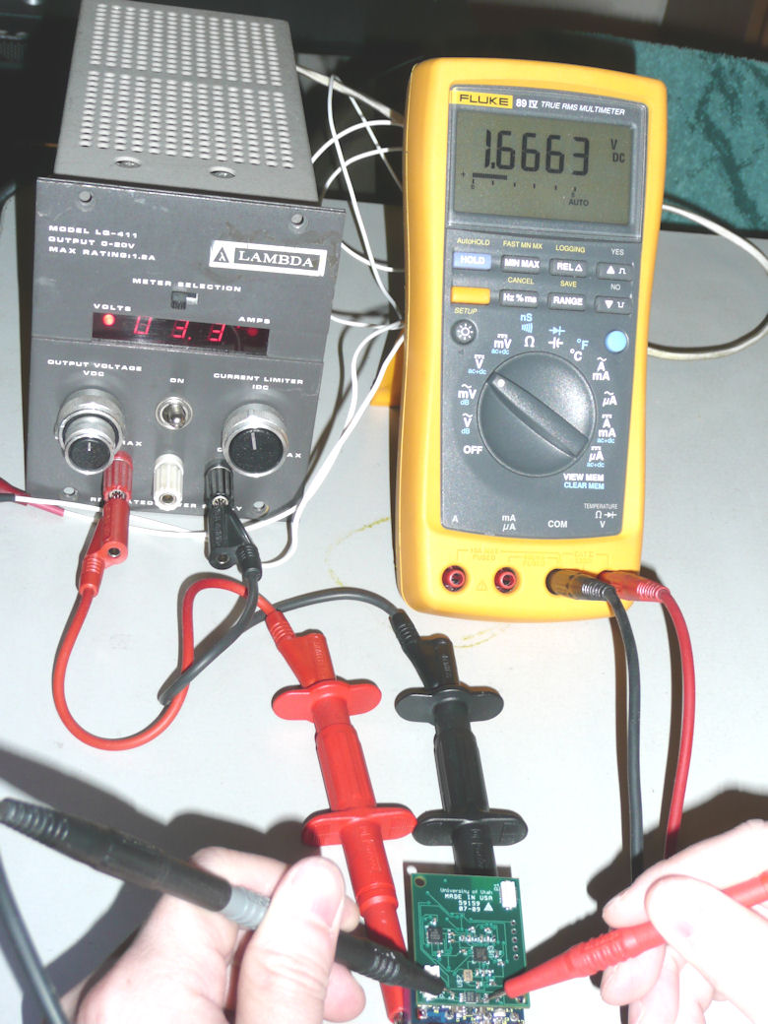
Voltage problems
Voltage Input Problem.
With 3.3V as Input the Output of Voltage Regulator was 1.66V

Slide 77
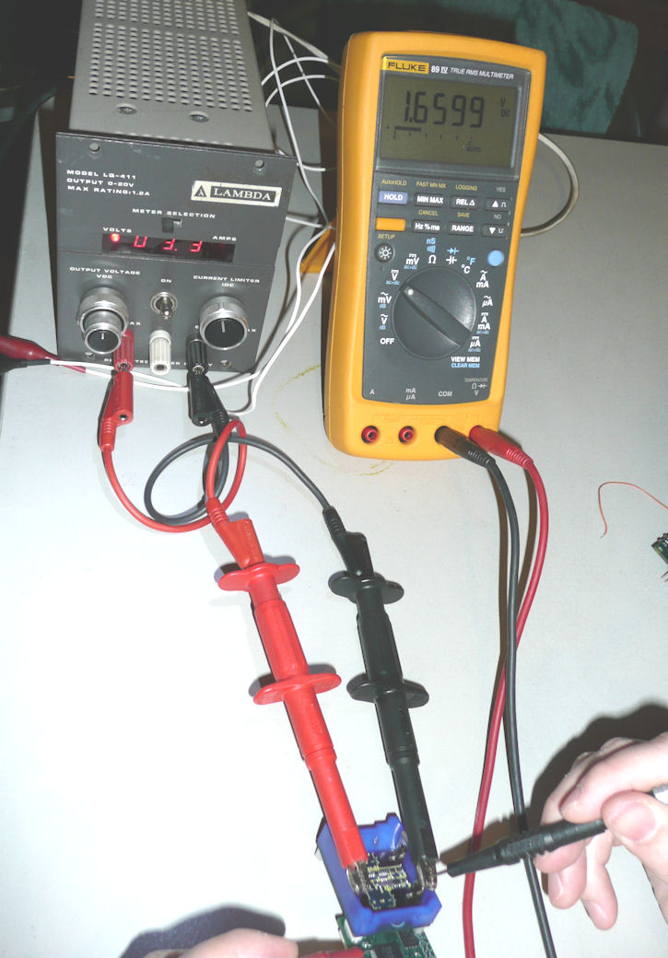
Voltage problems
Voltage Input Problem.
Since Vcc was set by Voltage Regulator of 1.66V, the input for Micro Processor was not enough to power it on.
Most devices on the board required 3.3V to operate in normal range with around 2.0V as min operating voltage.

Slide 78
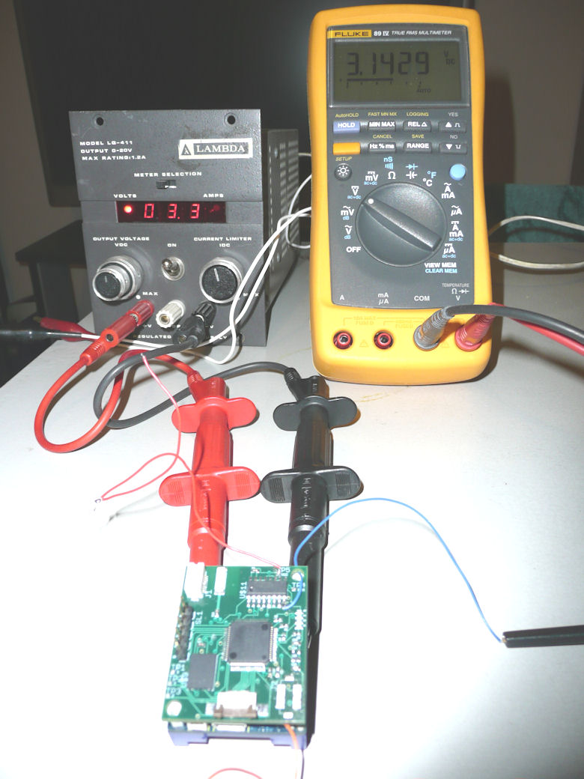
Voltage problems
Fix for voltage problem.
The source of voltage drop was isolated to Micro Processor.
By removing pin 64 (Avcc) the Voltage Regulator was outputting correct voltage.
Input voltage to Voltage Regulator.

Slide 79
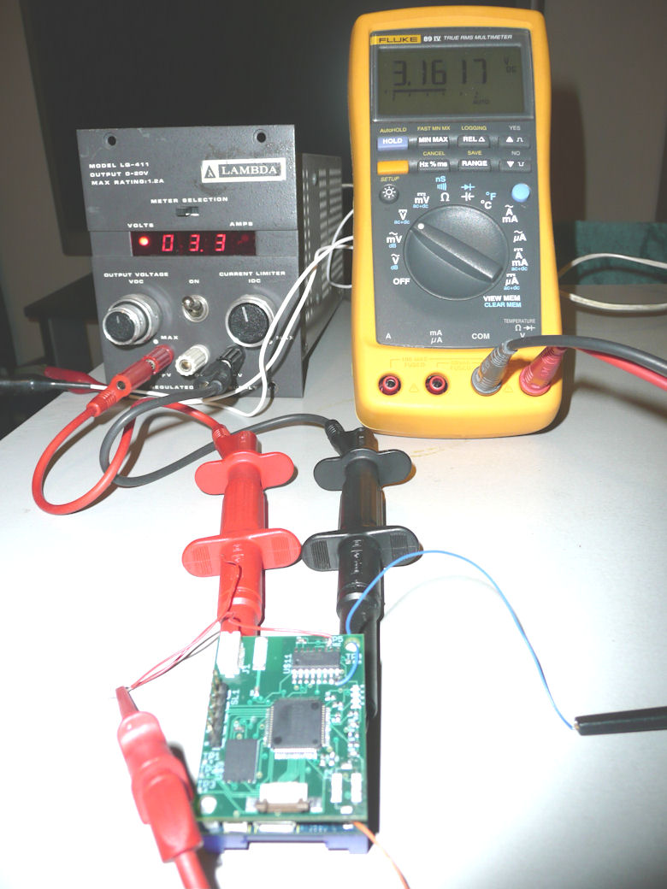
Voltage problems
Fix for voltage problem.
Output voltage of the Voltage Regulator.

Slide 80
Flashing Problems
Setup JTAG connections with IAR application.
IAR application could not detect our MSP430F169 microprocessor.

Slide 81
Flashing Problems
Verified Voltage Regulator was working.
Verified the JTAG connection was properly connected.
We took precautions in regard with electrostatic discharge.
All manufactured board will not flash correctly.

Slide 82
Flashing Problems
Isolated to the microprocessor.
Debugging plan is to acquire MSP430F169 and test it with the TI development kit.

Slide 83
Video clips
Accelerometer Operation
Programming / LED

Slide 84
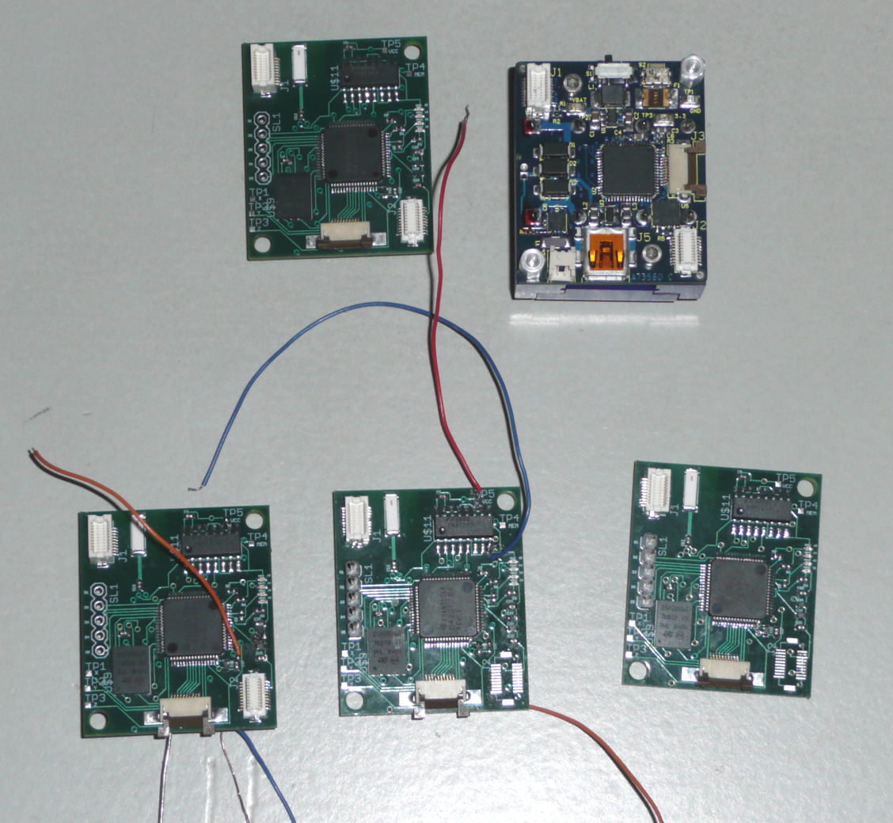
Board revisions

Slide 85
Planned application
Process RAW GPS Captures on PC.
Import calculated coordinates into file that can be processed by Google Earth (KMZ).
Plot Coordinates in Google Earth.

